Slide 1
Strings

Slide 2
Strings
A string is a sequence of letters (called characters).
In Python, strings start and end with single or double quotes.
>>> “foo”
‘foo’
>>> ‘foo’
‘foo’

Slide 3
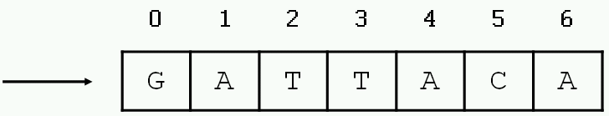
Defining strings
Each string is stored in the computer’s memory as a list of characters.
>>> myString = “GATTACA”
myString

Slide 4
Accessing single characters
You can access individual characters by using indices in square brackets.
>>> myString = “GATTACA”
>>> myString[0]
‘G’
>>> myString[1]
‘A’
>>> myString[-1]
‘A’
>>> myString[-2]
‘C’
>>> myString[7]
Traceback (most recent call last):
File "<stdin>", line 1, in ?
IndexError: string index out of range
Negative indices start at the end of the string and move left.

Slide 5
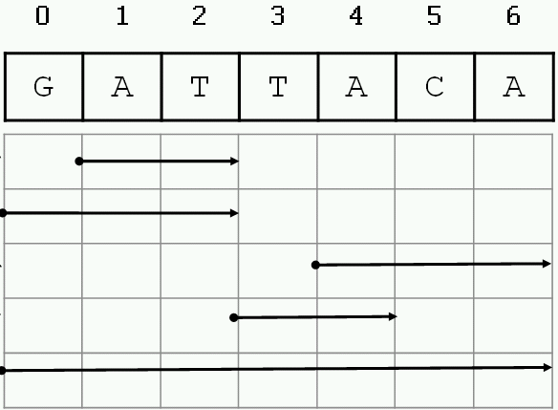
Accessing substrings
>>> myString = “GATTACA”
>>> myString[1:3]
‘AT’
>>> myString[:3]
‘GAT’
>>> myString[4:]
‘ACA’
>>> myString[3:5]
‘TA’
>>> myString[:]
‘GATTACA’

Slide 6
Special characters
The backslash is used to introduce a special character.
>>> "He said, "Wow!""
File "<stdin>", line 1
"He said, "Wow!""
^
SyntaxError: invalid syntax
>>> "He said, 'Wow!'"
"He said, 'Wow!'"
>>> "He said, \"Wow!\""
'He said, "Wow!"'
Escape sequence | Meaning
\\ | Backslash
\’ | Single quote
\” | Double quote
\n | Newline
\t | Tab

Slide 7
More string functionality
>>> len(“GATTACA”)
7
>>> “GAT” + “TACA”
‘GATTACA’
>>> “A” * 10
‘AAAAAAAAAA
>>> “GAT” in “GATTACA”
True
>>> “AGT” in “GATTACA”
False
Length
Concatenation
Repeat
Substring test

Slide 8
String methods
In Python, a method is a function that is defined with respect to a particular object.
The syntax is <object>.<method>(<parameters>)
>>> dna = “ACGT”
>>> dna.find(“T”)
3

Slide 9
String methods
>>> "GATTACA".find("ATT")
1
>>> "GATTACA".count("T")
2
>>> "GATTACA".lower()
'gattaca'
>>> "gattaca".upper()
'GATTACA'
>>> "GATTACA".replace("G", "U")
'UATTACA‘
>>> "GATTACA".replace("C", "U")
'GATTAUA'
>>> "GATTACA".replace("AT", "**")
'G**TACA'
>>> "GATTACA".startswith("G")
True
>>> "GATTACA".startswith("g")
False

Slide 10
Strings are immutable
Strings cannot be modified; instead, create a new one.
>>> s = "GATTACA"
>>> s[3] = "C"
Traceback (most recent call last):
File "<stdin>", line 1, in ?
TypeError: object doesn't support item assignment
>>> s = s[:3] + "C" + s[4:]
>>> s
'GATCACA'
>>> s = s.replace("G","U")
>>> s
'UATCACA'

Slide 11
Strings are immutable
String methods do not modify the string; they return a new string.
>>> sequence = “ACGT”
>>> sequence.replace(“A”, “G”)
‘GCGT’
>>> print sequence
ACGT
>>> sequence = “ACGT”
>>> new_sequence = sequence.replace(“A”, “G”)
>>> print new_sequence
GCGT

Slide 12
STRING OPERATORS
TYPES OF STRING OPERATORS:-
BASIC OPERATORS
MEMBERSHIP OPERATORS
COMPARISON OPERATORS

Slide 13
BASIC OPERATORS
THE TWO BASIC OPERATORS OF STRING ARE:- + AND *. YOU HAVE USED THESE ARITHMETRIC OPERATORS BEFORE FOR ADDITION AND MULTIPLICATION RESPECTIVELY. BUT WHEN USED WITH STRINGS, + OPERATOR PERFORMS CONCATENATION RATHER THAN ADDITION AND * OPERATOR PERFORMS REPLICATION RATHER THAN MULTIPLICATION.
EXAMPLES:-
CONCATENATION:-
str1 = 'Hello'
str2 ='World!'
print('str1 + str2 = ', str1 + str2)
REPLICATION:-
str1 = 'Hello'
str2 ='World!'
print('str1 * 3 =', str1 * 3)

Slide 14
MEMBERSHIP OPERATORS
THERE ARE TWO MEMBERSHIP OPERATORS FOR STRING .THESE ARE IN AND NOT IN.
IN:- RETURNS TRUE IF A CHARACTER OR A SUBSTRING EXISTS IN THE GIVEN STRING; FALSE OTHERWISE.
EX:- "A" in "HEYA"
# RETURN TRUE
NOT IN:- RETURNS TRUE IF A CHARACTER OR A SUBSTRING DOES NOT EXIST IN THE GIVEN STRING; FALSE OTHERWISE.
EX:- "jap" not in "JAPAN"
# RETURN TRUE BECAUSE PYTHON IS CASE- SENSITIVE

Slide 15
COMPARISION OPERATORS
Python string comparison is performed using the characters in both strings. The characters in both strings are compared one by one. When different characters are found then their Unicode value is compared. The character with lower Unicode value is considered to be smaller.
EXAMPLES:-
print(fruit1 == 'Apple') # TRUE
print(fruit1 != 'Apple') # FALSE
print(fruit1 < 'Apple') # FALSE
print(fruit1 > 'Apple') # FALSE
print(fruit1 <= 'Apple') # TRUE
print(fruit1 >= 'Apple') # TRUE

Slide 16
String summary
Basic string operations:
S = "AATTGG" # assignment - or use single quotes ' '
s1 + s2 # concatenate
s2 * 3 # repeat string
s2[i] # index character at position 'i'
s2[x:y] # index a substring
len(S) # get length of string
int(S) # or use float(S) # turn a string into an integer or floating point decimal
Methods:
S.upper()
S.lower()
S.count(substring)
S.replace(old,new)
S.find(substring)
S.startswith(substring), S. endswith(substring)
Printing:
print var1,var2,var3 # print multiple variables
print "text",var1,"text" # print a combination of explicit text (strings) and variables

Slide 17
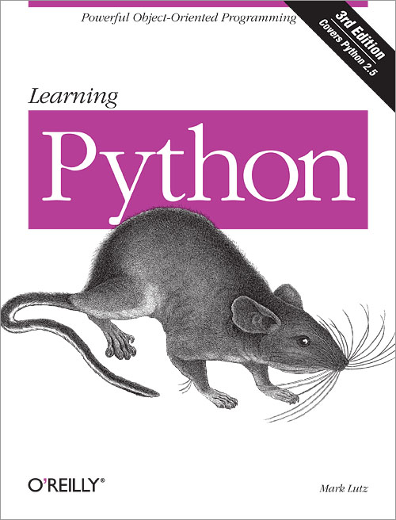
Reading
Chapters 5 and 8 of Learning Python by Lutz.

